Slide 1


@palinQA

Slide 2

Today’s Venue Host:

Slide 3
Thank you for being with palinQA in 2017!

Slide 4
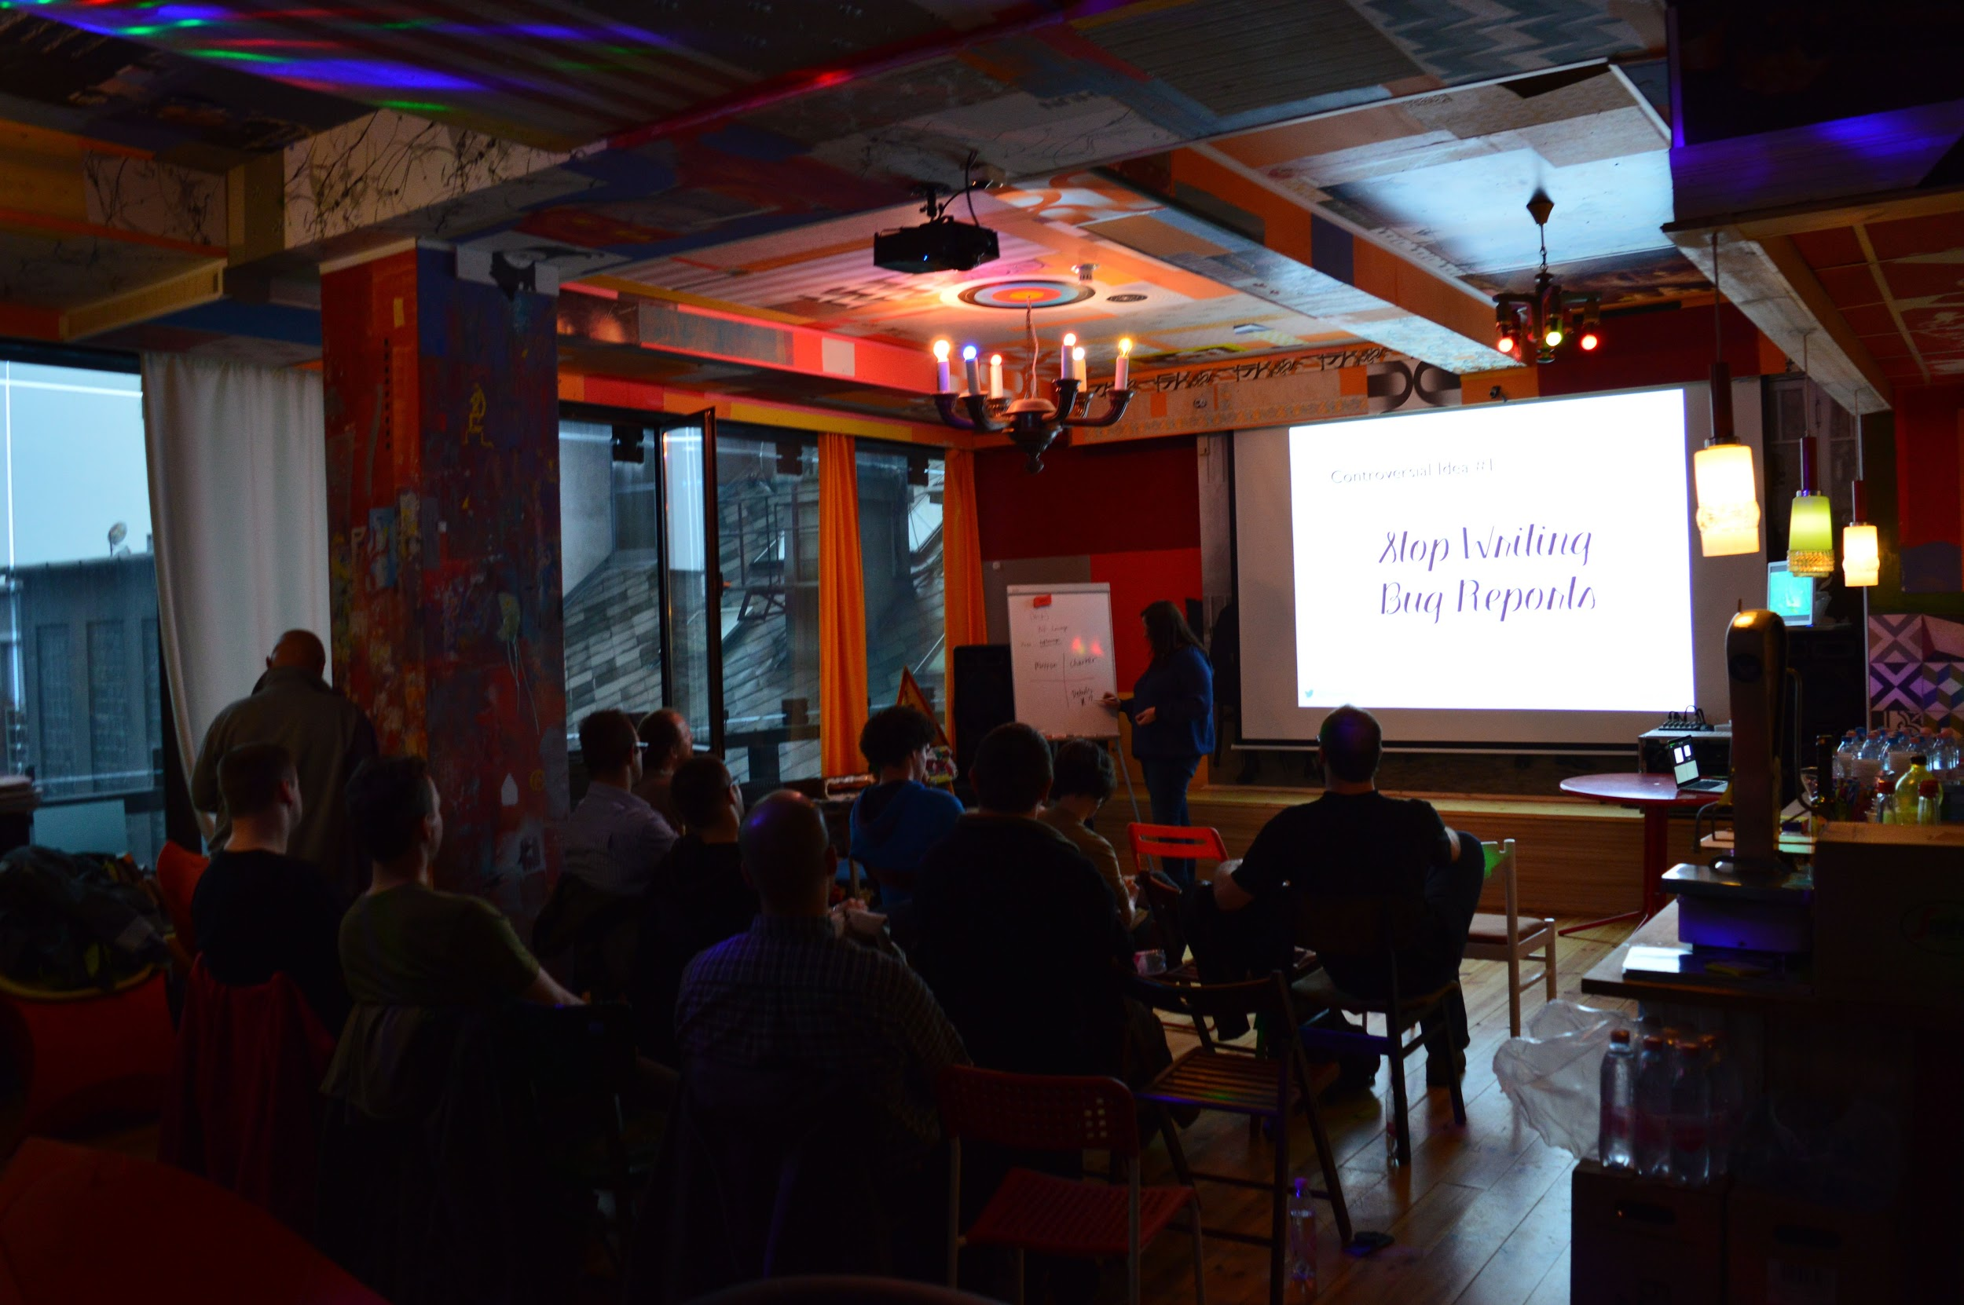
palinQA talks

Slide 5
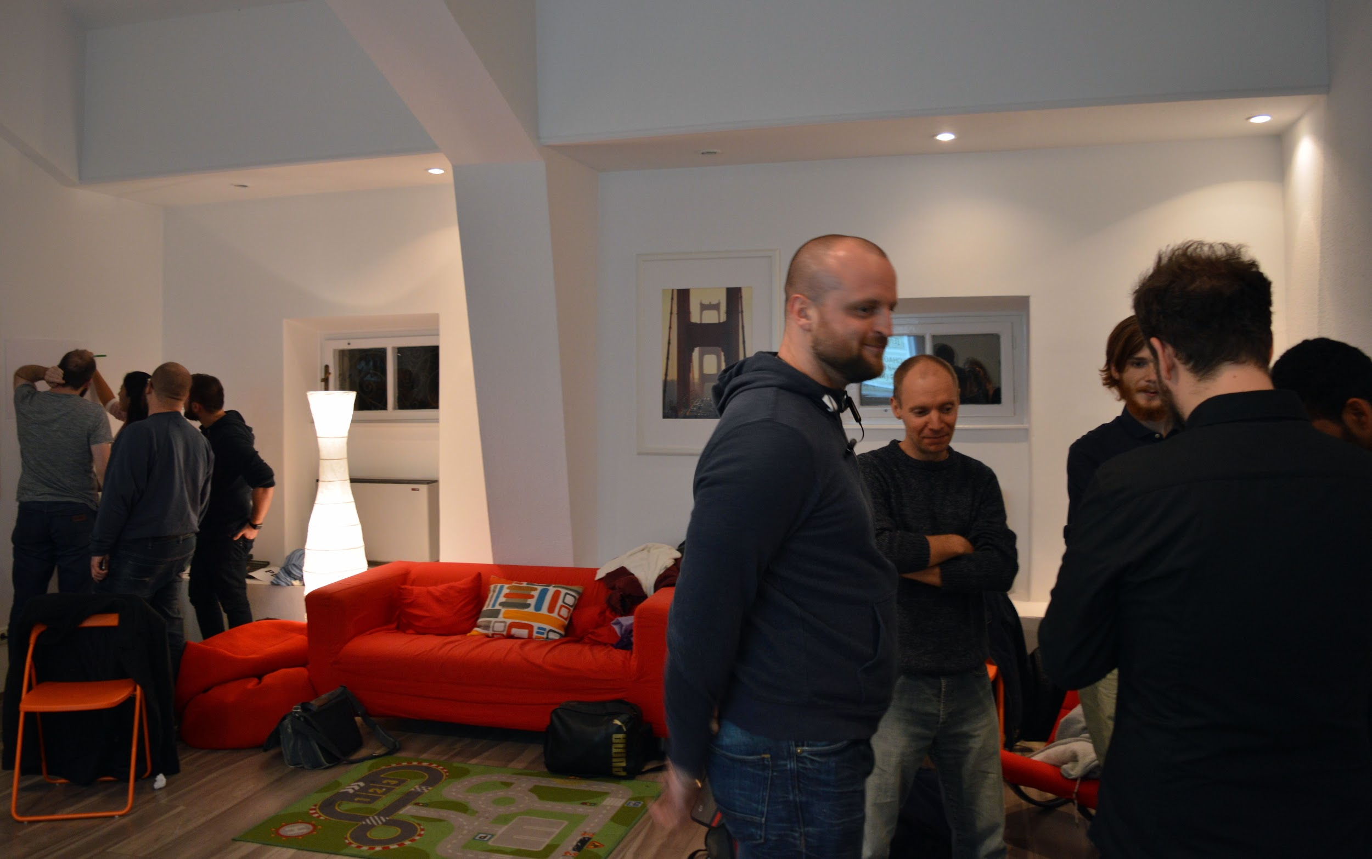
palinQA workshops

Slide 6
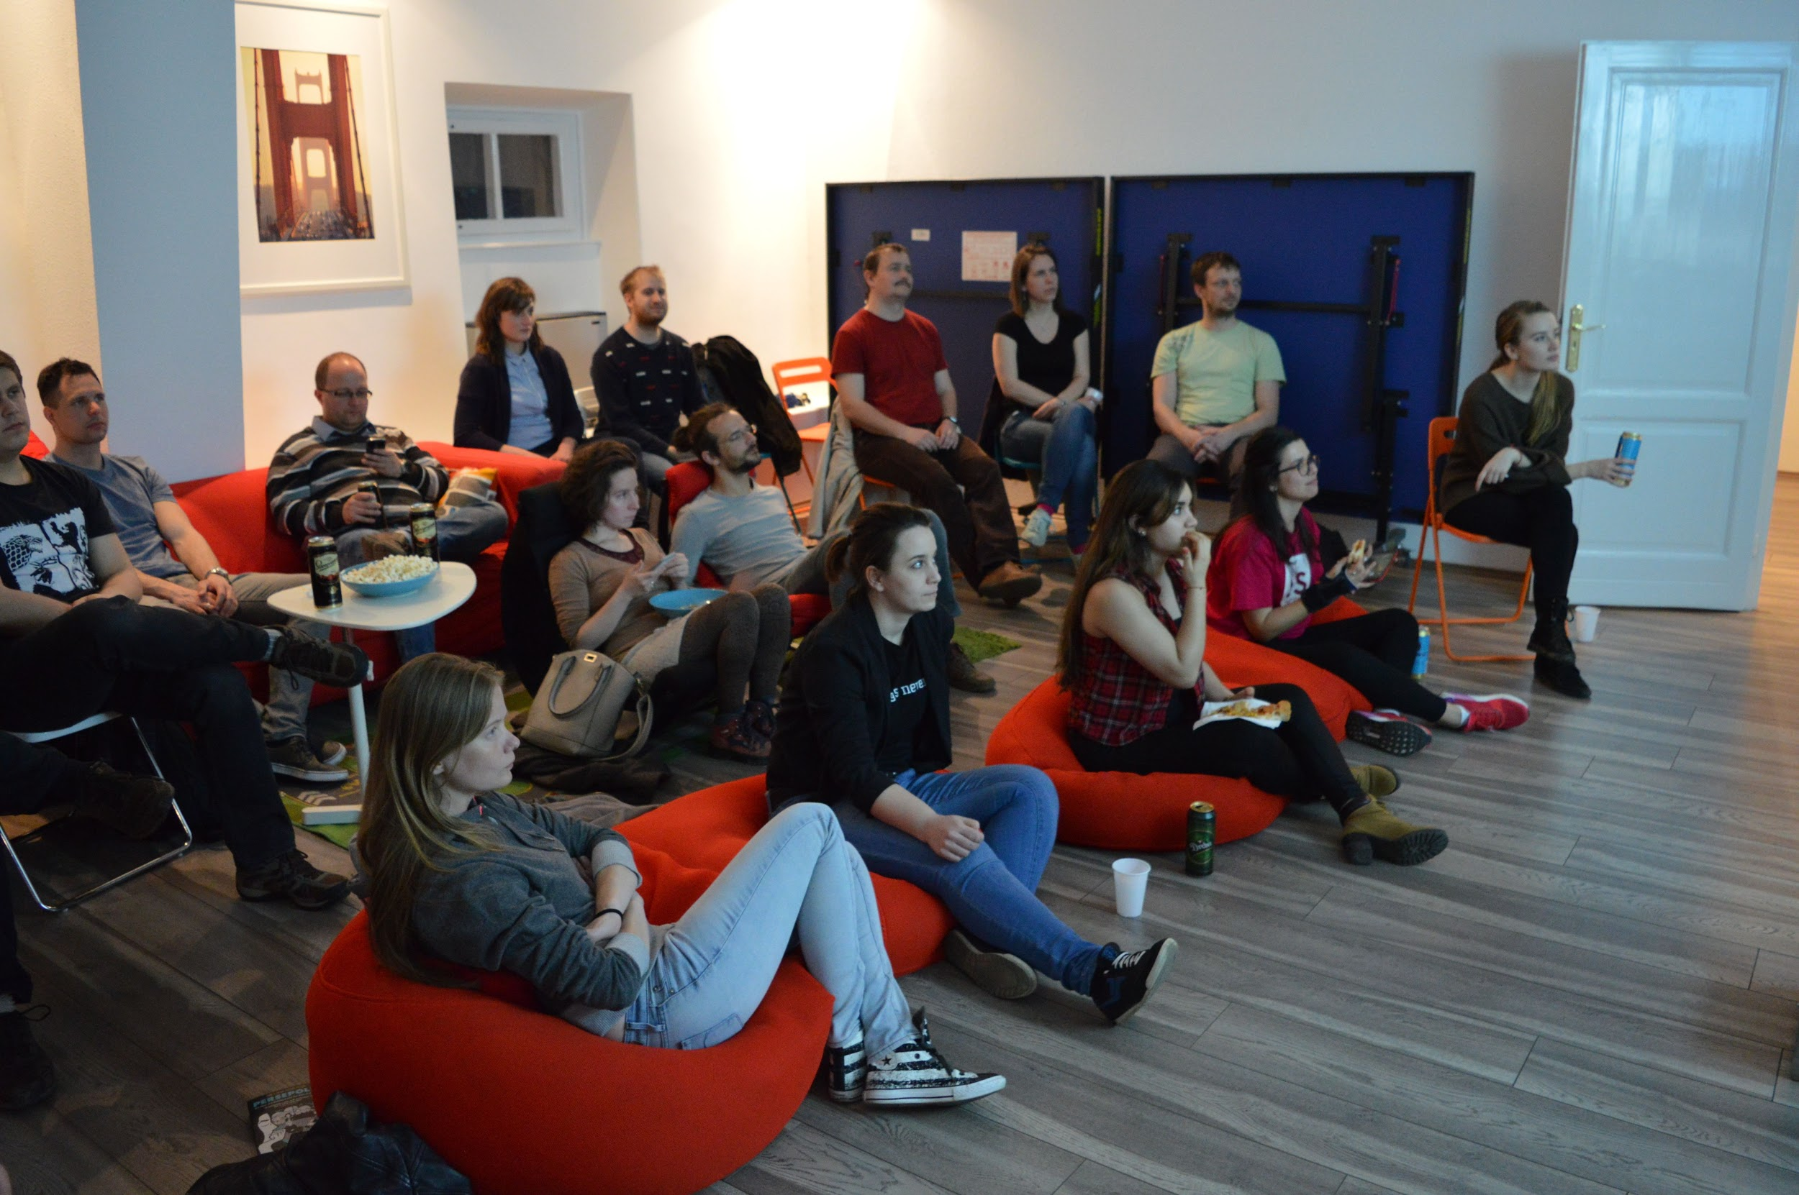
palinQA screening

Slide 7
Let’s kick off 2018!

Slide 8


Connect
@palinQA
testersbudapest.herokuapp.com

Slide 9

Code of Conduct

Slide 10

Speakers Wanted
We have CFP and can provide speaker mentoring!

Slide 11

Sponsors Wanted

Slide 12

Agenda
19:10 - 19:40 Manel Rhaiem
“How important is data quality for Data Engineer?”
19:45 - 20:15 Peter Czibik “Consumer-driven contract testing”
20:15 - Office tour and see you next time!

